Slide 1



Chipwhisperer
Smita Das
Secured Embedded and Architecture Laboratory (SEAL)
Department : Computer Science and Engineering
Bootcamp on Embedded Security and Trust (BEST 2025)

Slide 2
Overview
Side Channel Infrastructure
ChipWhisperer Setup
Trace collection using ChipWhisperer-Lite
CPA - Basics and implementation

Slide 3
Attack Model / Assumptions
Consider a device capable of implementing the cryptographic function
The key is usually stored in the device and protected
Modern cryptography is based on Kerckhoffs's assumption.
Any data other than the key is Public
Attacker only needs to extract the key

Slide 4
Attack Phases
Interaction phase: interact with the hardware system under attack and obtain the physical characteristics of the device
Analysis phase: analyze the gathered information to recover the key

Slide 5
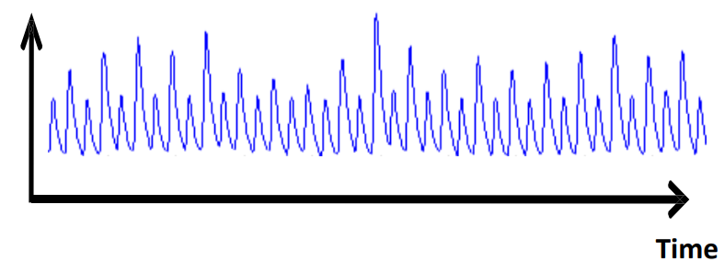
Side Channel Analysis Infrastructure
Side-Channel attacks aim at side-channel inputs and outputs, bypassing
the theoretical strength of cryptographic algorithms
Power Consumption : Logic circuits typically consume different amounts of power based on their input data

Slide 6
Side Channel Analysis Infrastructure
Electro-Magnetic:
Physically measure the electromagnetic emanations from an electronic device and use analytical methods and leakage models to steal information from the data.
EM attacks are non-invasive
This makes EM attacks powerful because they are easy for the attacker to perform. It only requires the use of a near-field probe and an oscilloscope.

Slide 7
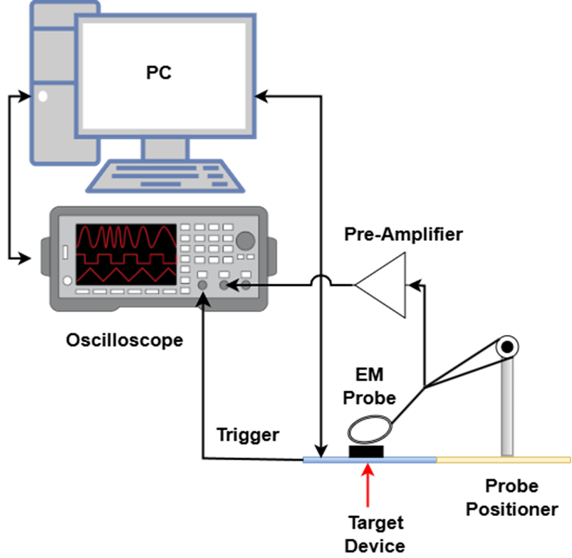
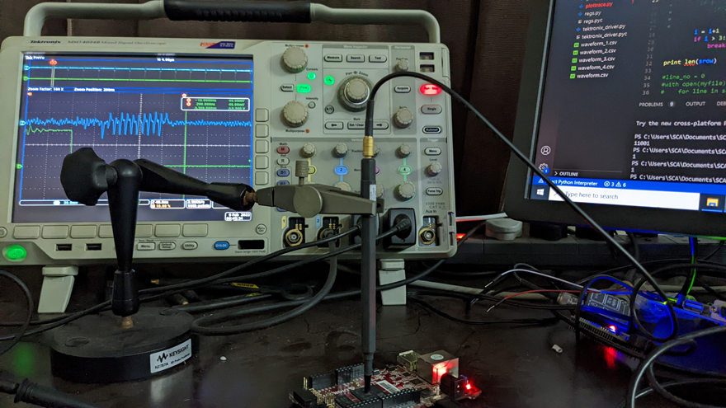
Existing Side Channel Analysis Infrastructure
Process description:
The Target Device executes some cryptographic algorithm
The radiations emanated by the target device is collected using the EM probe
The EM feeds the signal to an oscilloscope via a pre-amplifier
The data from the oscilloscope is further transferred on the host PC for further analysis

Slide 8
Can we bring down these large setup into an integrated device?

Slide 9
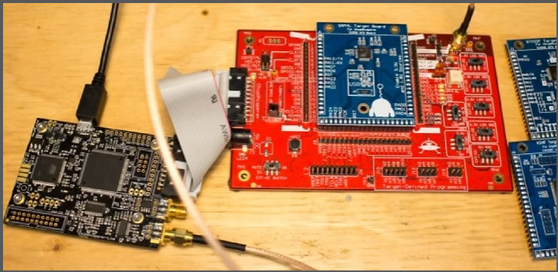
ChipWhisperer

Slide 10
Capture Boards
Five capture side hardware devices:
ChipWhisperer-Husky,
ChipWhisperer-Husky-Plus,
CW1200 ChipWhisperer-Pro (CWPro),
CW1173 ChipWhisperer-Lite (CWLite), and
CW1101 ChipWhisperer-Nano (CWNano)

Slide 11
ChipWhisperer-Lite
The ChipWhisperer-Lite typically comes with two main parts:
a multi-purpose power analysis capture instrument,
a target board
Features, such as SMA connectors for trigger input and output, allowing for easy interfacing with lab equipment.
Includes 8-bit Atmel XMEGA and 32-bit STM32F3 target devices

Slide 12
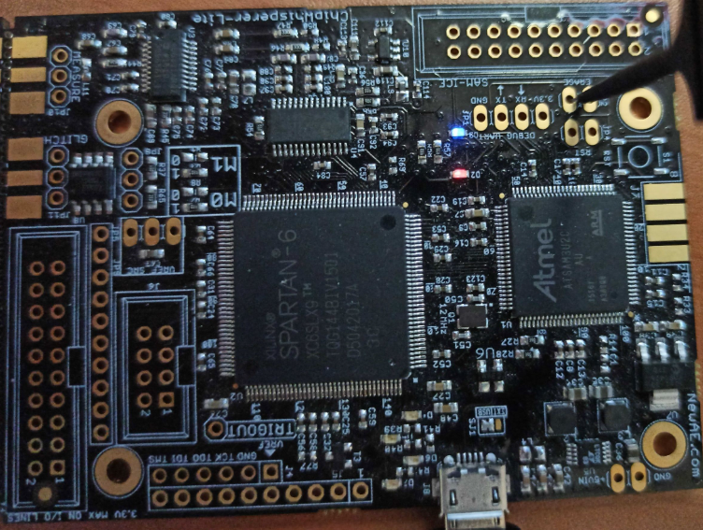
ChipWhisperer-Lite
Handles triggering for side-channel and fault injection attacks.
Atmel High Speed USB

Slide 13
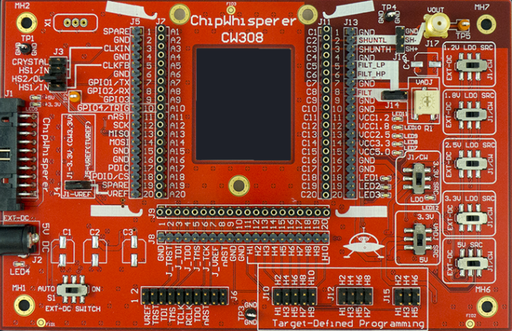
ChipWhisperer-Lite UFO board
Universal target board platform, providing power, clock, and trigger control for different target microcontrollers.

Slide 14
ChipWhisperer-Lite UFO board
It is the starting point for side-channel power analysis attacks when combined with a ChipWhisperer Capture solution.
The CW308 puts all the standard requirements onto one board (such as power supplies, oscillators) to make super-simple target victim boards.

Slide 15
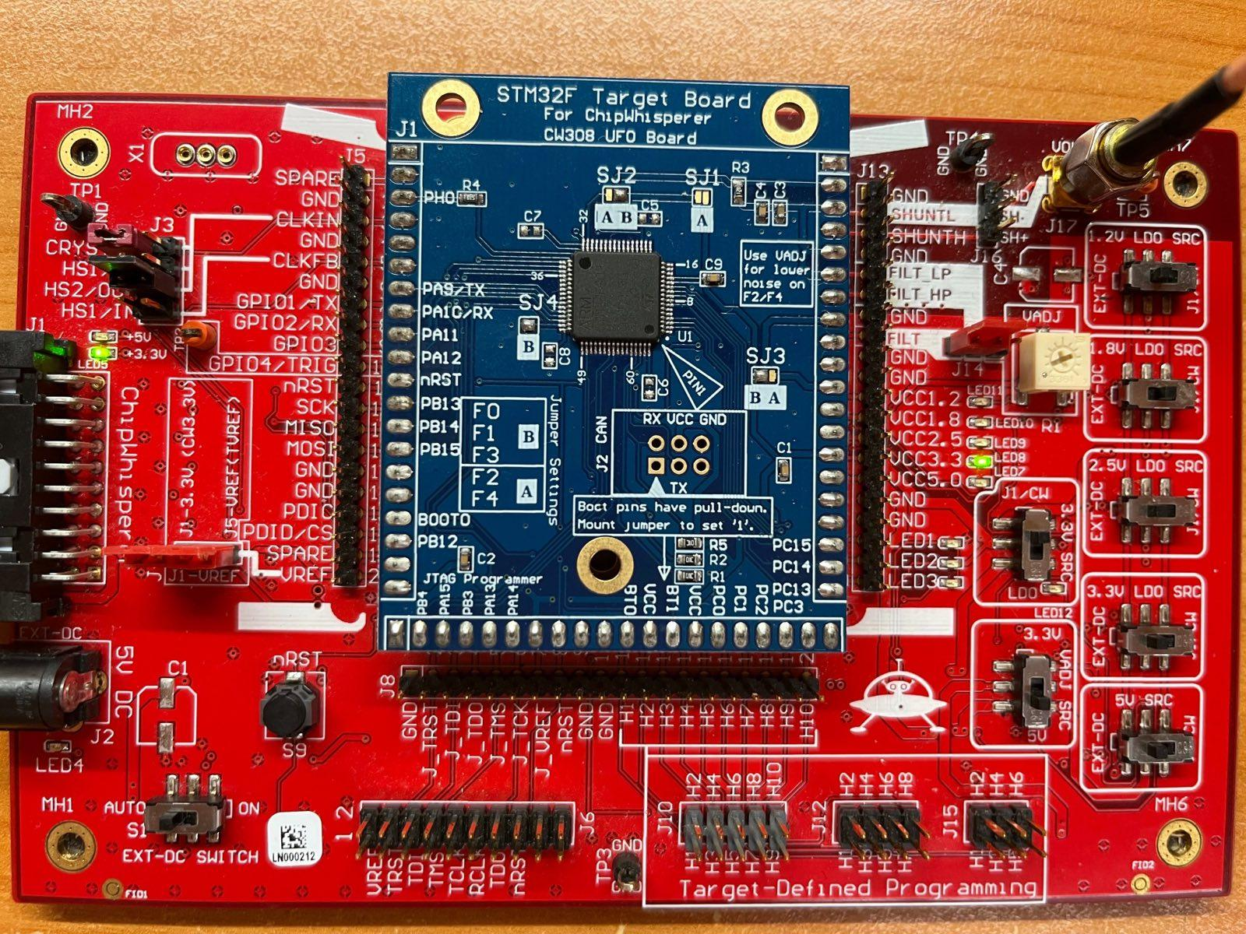
ChipWhisperer-Lite UFO board
It is the main-board for attacking all sorts of embedded targets.
STM32F Target

Slide 16
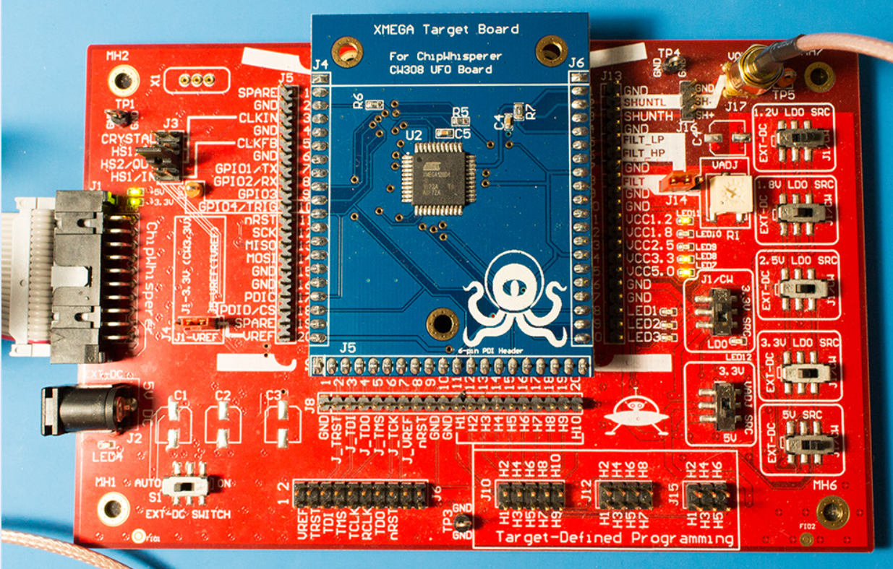
Chipwhisperer-Lite UFO board
It is the main-board for attacking all sorts of embedded targets.
CW308T-XMEGA Target

Slide 17
CW308 Details
The CW308 comes with the following parts
CW308 Main Board
CW308T-XMEGA Target Board (Atmel 8-bit microcontroller)
CW308T-STM32F3 Target Board (ARM Cortex M3)
CW308T Prototyping Boards (2.54mm prototyping board)
NPCB-CW308T-STM32F Blank PCB (Fits STM32F0, F1, F2, F3, F4)
Target Removal Tool
7.37 MHz crystal
8x jumper wires
30 cm SMA cable

Slide 18
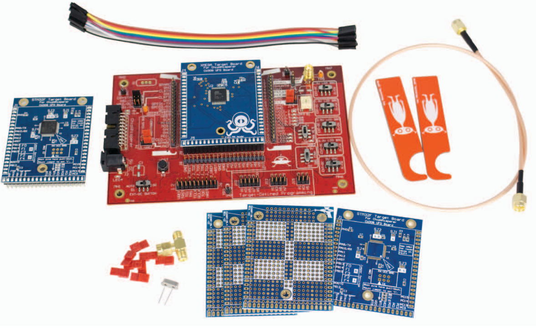
CW308 Details
8x Jumper Wires:connect signals between different parts of the CW308 board or external devices.
Connect the CW308 to ChipWhisperer for measuring power traces or injecting faults- SMA connector
XMEGA Target
STM32F Target
Board removal tool
Two SMA connectors on the board can be used for power measurement or glitch input
Crystal: external clock source for the target microcontroller
solder custom circuits, such as microcontrollers,

Slide 19
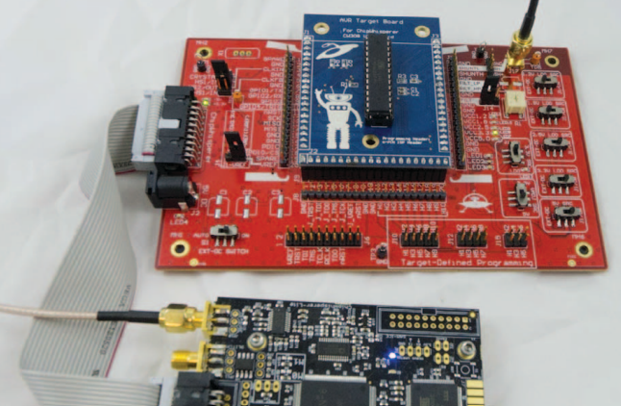
ChipWhisperer Capture
The capture hardware provides
power,
serial communication,
clock,
shunt resistor monitoring,
power and
voltage fault injection capability.
Select devices (XMEGA, and STM32Fx) targets can be programmed from the ChipWhisperer, avoiding the need for an external programmer.

Slide 20
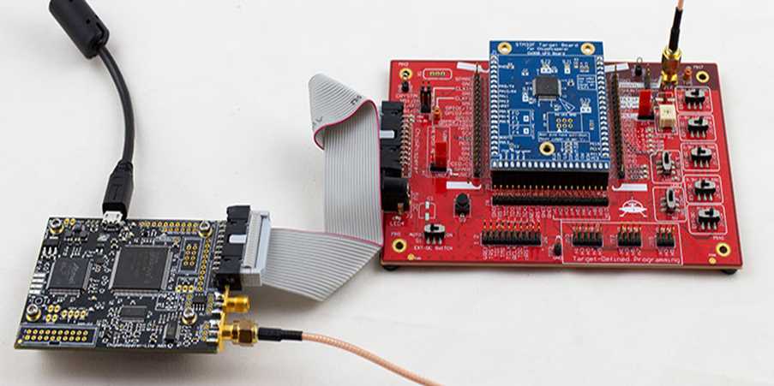
ChipWhisperer-Lite
Supplies power to the target board.
20-Pin Header connects Multi-Target to Capture Hardware

Slide 21
Scope API
Control the capture/glitch portion of the ChipWhisperer device.
Create a scope object via the chipwhisperer.scope() function, which will connect to a ChipWhisperer device and return a scope object of the correct type
There are currently two types of scopes:
OpenADC Scope (Lite, Pro, Husky)
ChipWhisperer Nano Scope (Nano)
This function allows any type of scope to be created.
By default, the object created is based on the attached hardware (OpenADC for CWLite/CW1200, CWNano for CWNano)Scope Types:
scopes.OpenADC (Pro and Lite)
scopes.CWNano (Nano)

Slide 22
OpenADC scope object: ChipWhisperer scope submodules
This class contains the public API for the OpenADC hardware, including the ChipWhisperer Lite.
To connect to one of these devices
scope.gain
scope.adc
scope.clock
scope.io
scope.trigger
scope.glitch (Lite/Pro)
scope.default_setup
scope.con
scope.dis
scope.arm
scope.get_last_trace
Setup scope to begin capture/glitching when triggered.

Slide 23
OpenADC scope object: ChipWhisperer scope submodules
Scope Attributes
scope.gain
Controls the gain (amplification) of the signal captured by the ADC.
scope.adc
Represents the analog-to-digital converter (ADC) settings.
Includes parameters like the sampling rate, offset, and triggering settings.
scope.clock
Handles clock settings for the target and glitch module.
scope.io
Manages I/O pins on the ChipWhisperer device.
scope.trigger
Configures the trigger module, which determines when the scope starts capturing traces.
Triggers can be based on rising edges, falling edges, or specific signal levels.
scope.glitch
Manages glitching settings, including width, offset, and trigger conditions.
Used for voltage or clock glitching attacks.

Slide 24
OpenADC scope object: ChipWhisperer scope submodules
Scope Methods
scope.default_setup()
Resets the scope to default settings.
scope.con()
Connects to the ChipWhisperer hardware.
scope.dis()
Disconnects from the ChipWhisperer hardware.
scope.arm()
Arms the scope to start capturing power traces once a trigger event occurs.
scope.get_last_trace()
Retrieves the last captured power trace after a successful capture.

Slide 25
OpenADC scope object: ChipWhisperer scope submodules
Scope Default setup
Sets the scope gain to 45dB
Sets the scope to capture 5000 samples
Sets the scope offset to 0 (i.e., it will begin capturing as soon as it is triggered)
Sets the scope trigger to rising edge
Outputs a 7.37MHz clock to the target on HS2
Clocks the scope ADC at 4*7.37MHz. Note that this is synchronous to the target clock on HS2
Assigns GPIO1 as serial RX ( allowing data receiving from the target)
Assigns GPIO2 as serial TX ( allowing data transmission to the target)

Slide 26
Building and Uploading Firmware
// Uses TinyAES for encryption
Attacking a target :
Get some firmware built and uploaded onto it.
Fill in your platform, re-run the build command, and firmware should be successfully built.
PLATFORM=CW308_STM32F3

Slide 27
Communication with the Target
Done through the SimpleSerial target object.
Grouped into two categories:
Raw serial via target.read(), target.write(), target.flush(), etc.
SimpleSerial commands via target.simpleserial_read(), target.simpleserial_write(), target.simpleserial_wait_ack(), etc.
The firmware we uploaded uses the simpleserial protocol

Slide 28
Communication with the Target
SimpleSerial is a lightweight communication protocol used by ChipWhisperer to send and receive data between a host PC and a target device (XMEGA or STM32 microcontroller)
Uses UART (serial communication) for data exchange
HEX File Generated After Make Firmware
Contains machine instructions for the microcontroller

Slide 29
Communication with the Target
Encryption Application
The encryption application provides a simple method to encrypt a plaintext into a ciphertext. The following operations are performed:
Load encryption key with 'k' command (
Eg: k2b7e151628aed2a6abf7158809cf4f3c\n sets key to 2b7e151628aed2a6abf7158809cf4f3c).
Set input text to encryption module with 'p' command.
Device encrypts input text, and toggles the I/O trigger line during the encryption operation.
The ciphertext is returned with the 'r' command.

Slide 30
Capturing Traces
Arm the ChipWhisperer with scope.arm()
It will begin capturing as soon as it is triggered
scope.capture()
read back the captured power trace, blocking until either ChipWhisperer is done recording, or the scope times out.
Read back the captured power trace with scope.get_last_trace()

Slide 31
Capturing Traces
simpleserial_base will trigger the ChipWhisperer when we send the 'p' command. Try capturing a trace now
ChipWhisperer also has a capture_trace() convenience function that:
Optionally sends the 'k' command
Arms the scope
Sends the 'p' command
Captures the trace
Reads the return 'r' as response
Returns a Trace class that groups the trace data, 'p' message, the 'r' response, and the 'k' key.

Slide 32
Disconnect from the hardware

Slide 33
Useful Links
https://rtfm.newae.com/Capture/ChipWhisperer-Lite/
https://www.newae.com/products/nae-cw1173
https://chipwhisperer.readthedocs.io/en/latest/windows-install.html
Anaconda
ARM GCC Compiler
Visual Studio Code

Slide 34
Let’s try to capture some trace and perform Correlation Power Attack (CPA)

Slide 35
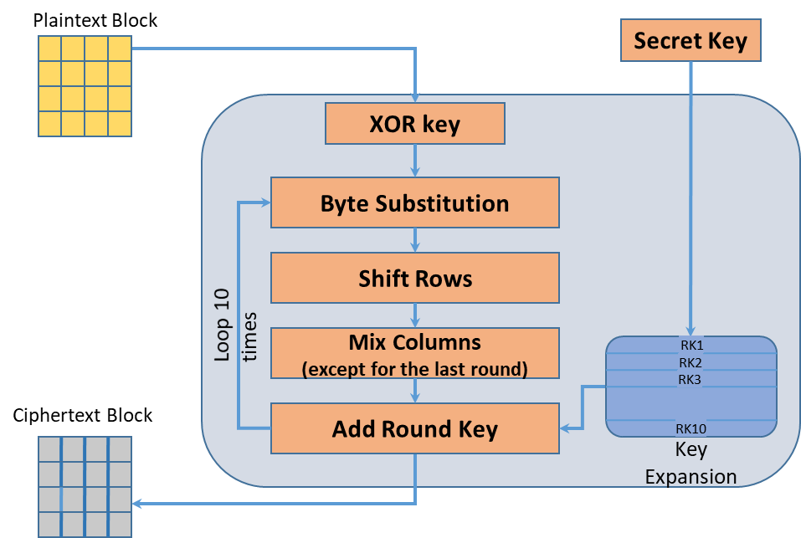
AES-128 Encryption

Slide 36
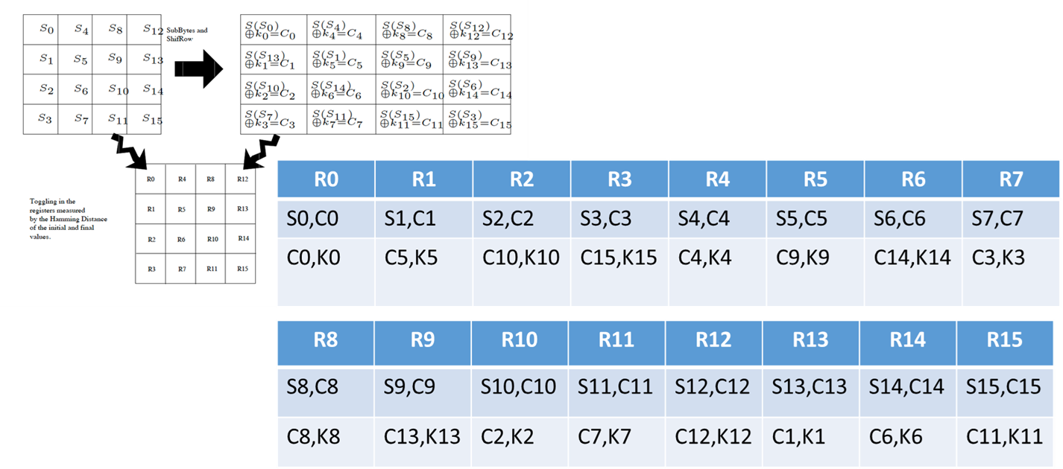
Calculating the Hypothetical Power

Slide 37
Computing the Correlation Matrix
Actual Power values for all the NSample encryptions are stored in the array trace[NSample][NPoint].
Attacker first scans each column of this array and computes the average, and stores in meanTrace[NPoint].
Likewise, the hypothetical power is stored in the array hPower[NSample][NKey].
Attacker scans each column and stores in the array meanH[NKey]

Slide 38
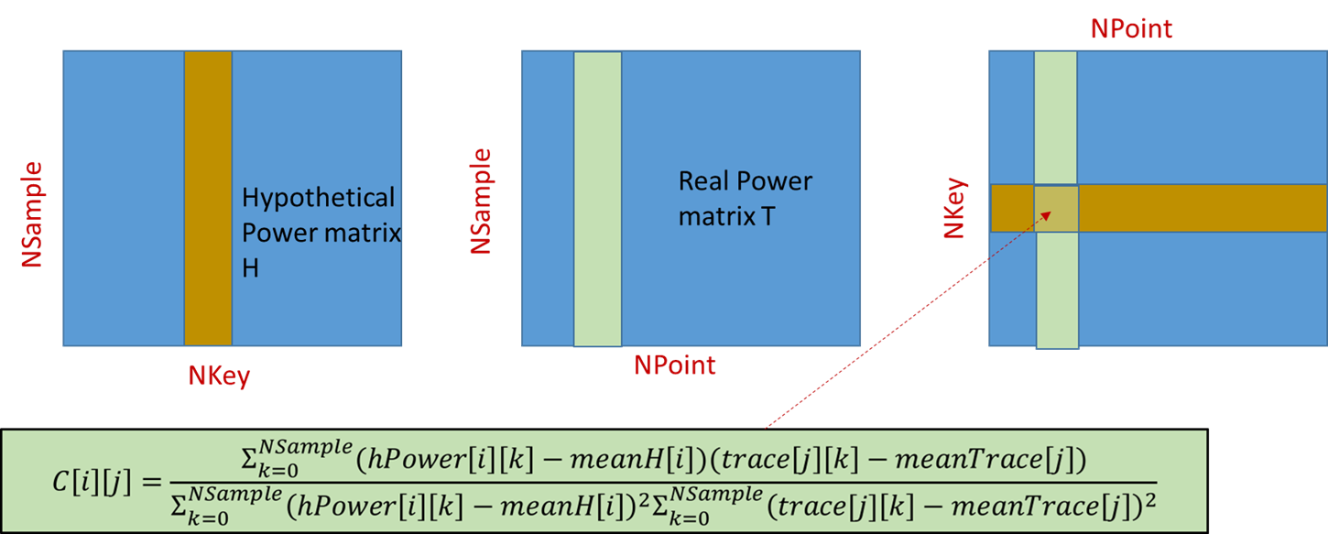
Correlation Matrix

Slide 39
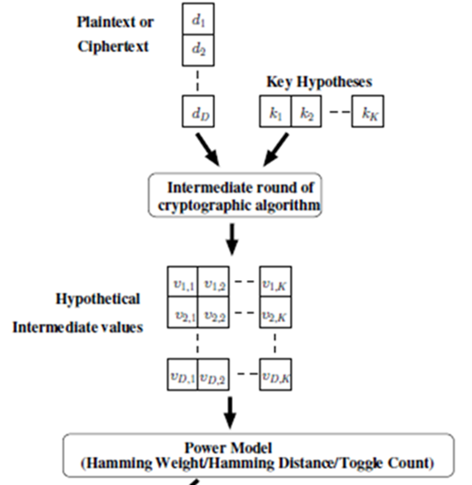
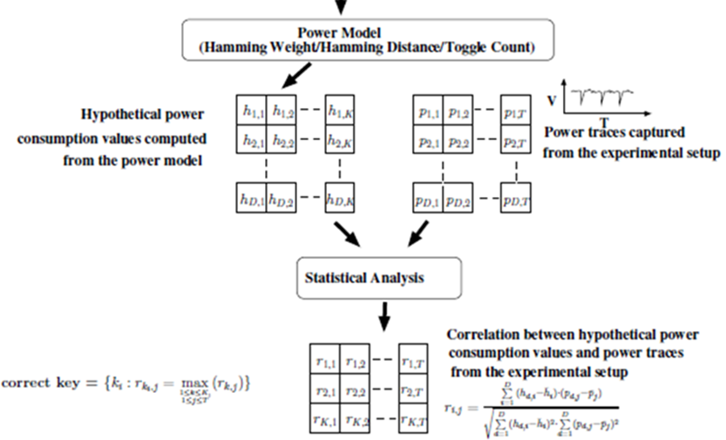
Correlation Matrix

Slide 40
Fault Attack

Slide 41
Electromagnetic Fault Injection:
Emission of electromagnetic pulses on a specific location of the device can induce a fault.
Laser Fault Injection:
Emitting a laser pulse to a specific location of a device can cause a fault.
The control of the attack is very high compared to the previous ones.
This attack is invasive, since the packaging of the target chip must be at least partially removed (decapsulation).

Slide 42
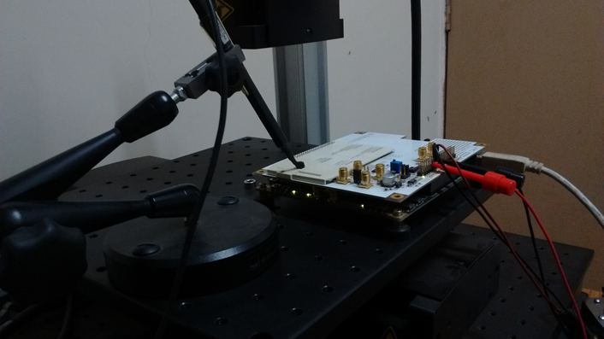
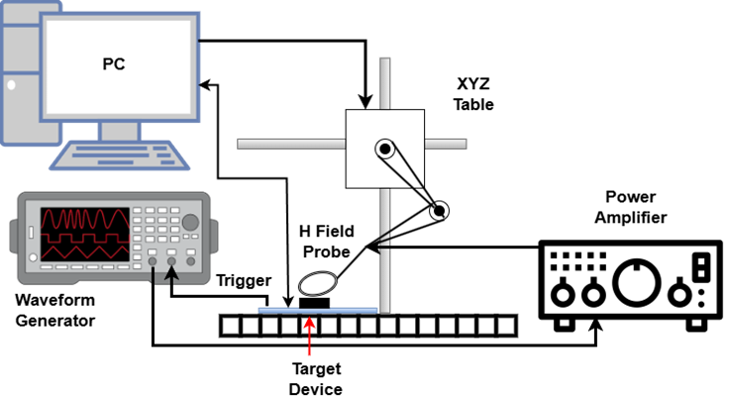
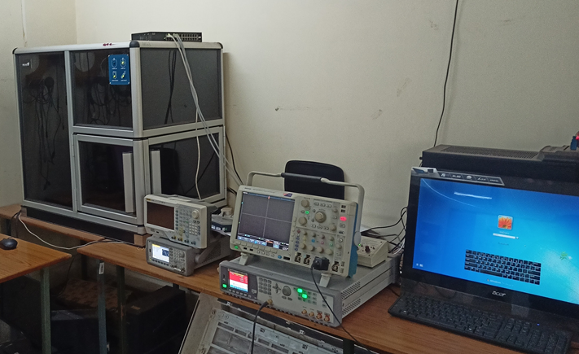
Existing Fault Attack Infrastructure
EM fault injection setup
Components in the setup:
Arbitrary waveform generator: Keysight 81160A
Constant-gain power amplifier: Teseq CBA 400M-260
High-frequency near field H-probe: Rigol Near-field Probe 30MHz-3GHz
XYZ table: Thorlabs SMC100
EM Fault injection along with side channel observation setup

Slide 43
Thank You

